Slide 1

Temple University Bursar’s Office

Slide 2
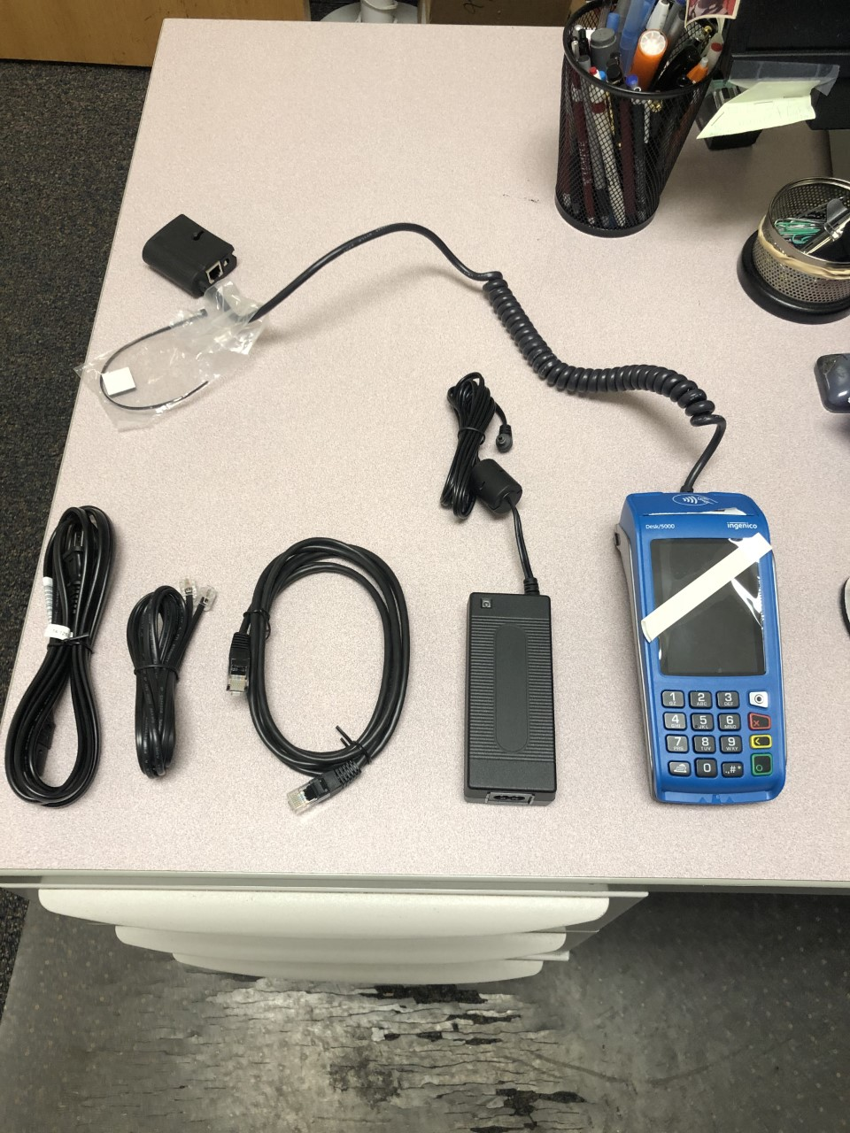
Terminal Install

Slide 3
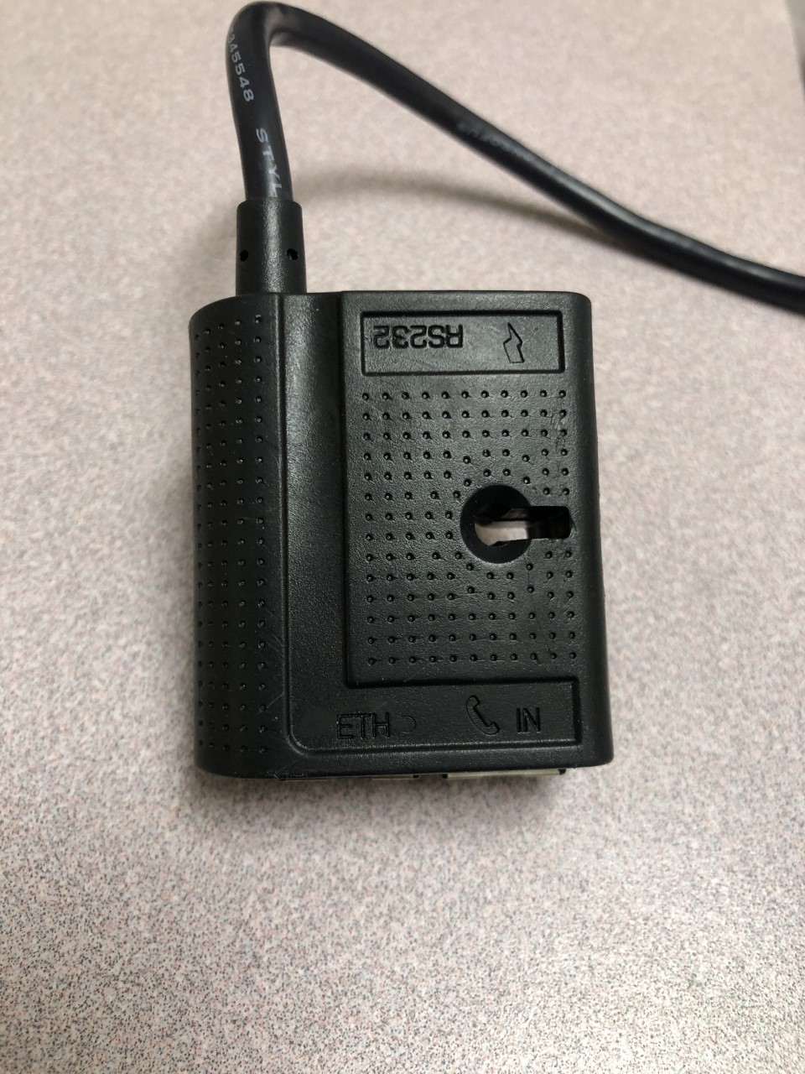
Terminal Install

Slide 4
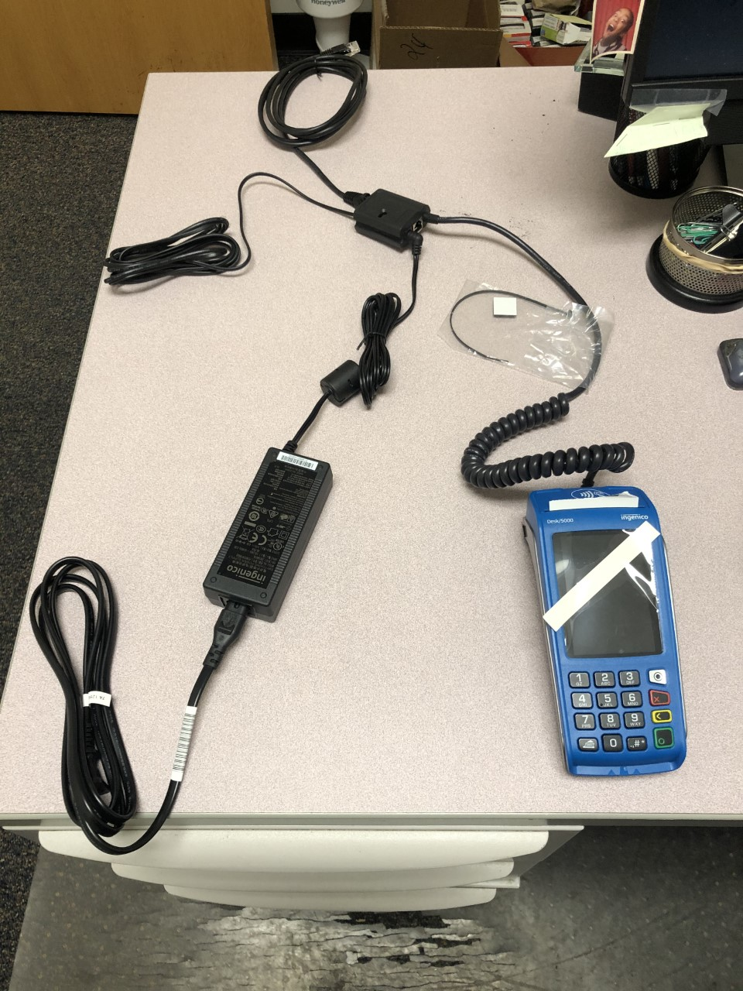
Terminal Install

Slide 5
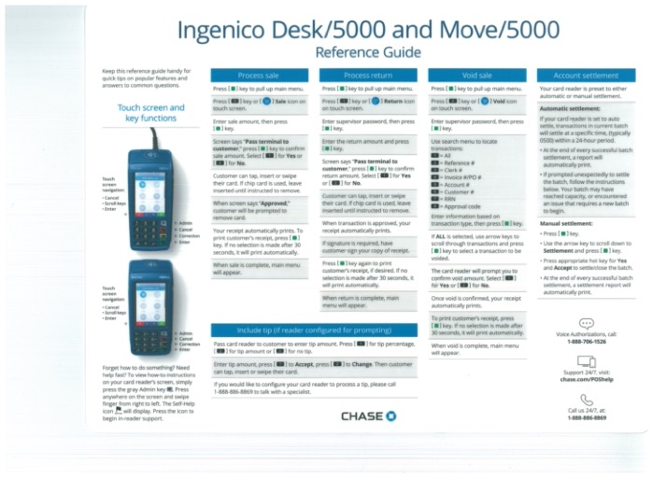
Transactions

Slide 6
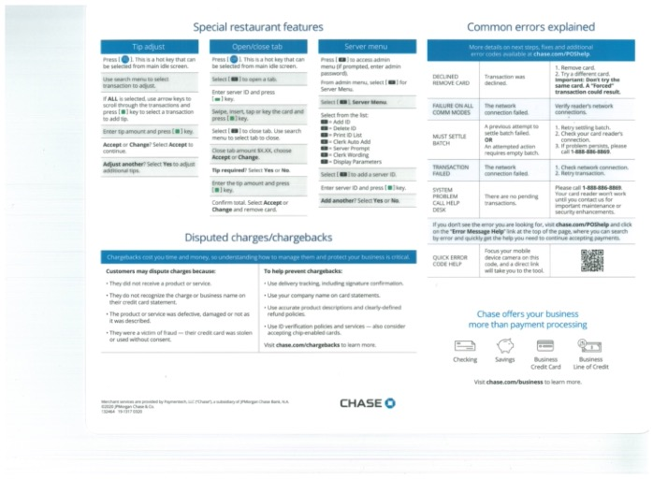
Transactions

Slide 7

Credit Card Handling & Acceptance
Hope.Wardell@temple.edu

Slide 8
Agenda
Policy & Rational
Key Points
Personal Identifiable Information (PII)
Do’s and Don’t for handling PII
Things to Remember
Security Ethics Certification (SEC)

Slide 9
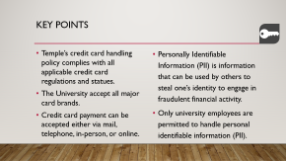
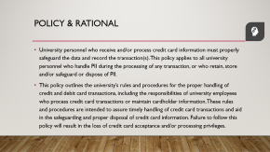
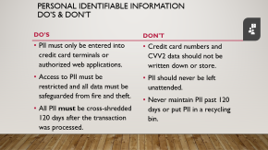
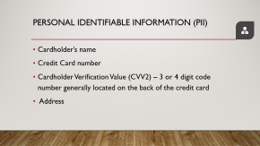

Slide 10

Policy & rational
University personnel who receive and/or process credit card information must properly safeguard the data and record the transaction(s). This policy applies to all university personnel who handle PII during the processing of any transaction, or who retain, store and/or safeguard or dispose of PII.
This policy outlines the university’s rules and procedures for the proper handling of credit and debit card transactions, including the responsibilities of university employees who process credit card transactions or maintain cardholder information. These rules and procedures are intended to assure timely handling of credit card transactions and aid in the safeguarding and proper disposal of credit card information. Failure to follow this policy will result in the loss of credit card acceptance and/or processing privileges.
Notes:
During the course of processing a credit card transaction all university employees must properly safeguard data. Today, I will discuss the university’s rules and procedures for properly retaining, processing, storing, safeguarding, and disposing of personal identifiable information. Failure to follow this policy will result in the loss of credit card processing privileges.

Slide 11

Key Points
Temple’s credit card handling policy complies with all applicable credit card regulations and statues.
The University accept all major card brands.
Credit card payment can be accepted either via mail, telephone, in-person, or online.
Personally Identifiable Information (PII) is information that can be used by others to steal one’s identity to engage in fraudulent financial activity.
Only university employees are permitted to handle personal identifiable information (PII).
Notes:
Before we begin I would like to just quickly point out a few key points: (READ SLIDE)

Slide 12

Personal identifiable information (PII)
Cardholder’s name
Credit Card number
Cardholder Verification Value (CVV2) – 3 or 4 digit code number generally located on the back of the credit card
Address
Notes:
Personally identifiable information ( PII ) is any information about an individual that can be used directly, or in connection with other data, to identify, contact, locate, or commit a fraud against that person. As it relates to credit card processing PII is recognized as the: (READ SLIDE)

Slide 13

Personal identifiable information do’s & don’t
Do’s
Don't
PII must only be entered into credit card terminals or authorized web applications.
Access to PII must be restricted and all data must be safeguarded from fire and theft.
All PII must be cross-shredded 120 days after the transaction was processed.
Credit card numbers and CVV2 data should not be written down or store.
PII should never be left unattended.
Never maintain PII past 120 days or put PII in a recycling bin.
Notes:
So, let take about the Do’s and Don’t when dealing with PII.

Slide 14

Things to remember
Immediately notify your supervisor if you suspect that PII is missing or compromised.
All credit card terminals and web applications must be closed out and reconciled on a daily basis.
If you suspect fraudulent activity you must contact, Information Security Office, University Privacy Officer, and the Bursar’s Office.

Slide 15
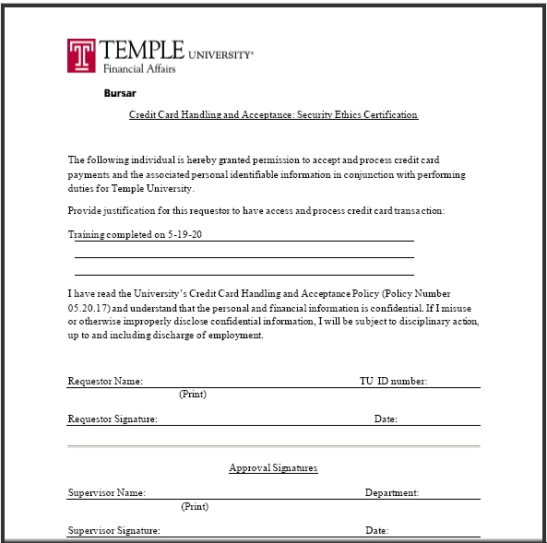

Security ethics certification
A copy of the Security Ethics Certification (SEC) will be e-mailed to you and your supervisor to sign.
The signed SEC document must be sent to: hope.Wardell@temple.edu

Slide 16
Side Items
Processing a Transaction
Credit Card disputes
Transaction Voids/Returns Authorization code is CPS2468 (may need a new code).
JP Morgan Tech Support 1-888-886-8869 24hrs.
Each merchant’s FOAP will be assessed any merchant fees related to their terminal.
Resource Online training access for department admin only.
Notes:
https://jpmchase.webex.com/meet/RAMON.LOZANO

Slide 17

Questions
Hope.Wardell@temple.edu

